Slide 1
The Choice Theory
Model of rational decision making

Slide 2
The Rational Decision Process
The optimizing decision maker is rational.
The final (decision-making step before implementation) requires computing the optimal decision based on an evaluation of the alternatives.

Slide 3
Assumptions
The rational model of decision making assumes that people will make choices that maximize benefits and minimize any costs. The idea of rational choice is easy to see in economic theory.
An individual has full and perfect information on which to base a choice.
Measurable criteria exist for which data can be collected and analyzed.
An individual has the cognitive ability, time, and resources to evaluate each alternative against the others.

Slide 4
The Rational Decision Process
The Methodical Approach
Or
Traditional Problem Solving Model

Slide 5
The Process of Rational Decision Making
The approach follows a sequential and formal path of activities. This path includes:
Formulating a goal(s)/problem
Identifying the criteria for making the decision
Identifying alternatives
Performing analysis
Making a final decision.

Slide 6
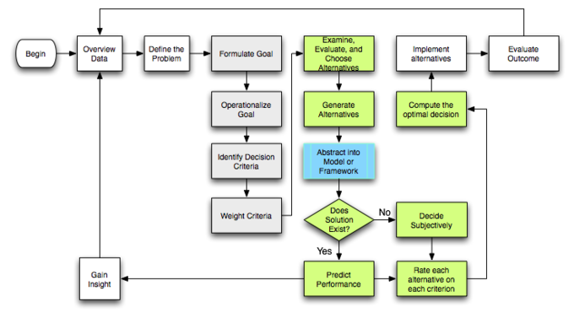

Slide 7
Expansion of the model
1. Formulating the problem - the way a problem is identified and defined will determine the actions that we decide to take to solve a problem

Slide 8
Continued…
2. Interpreting the problem - the opportunity to find an effective solution to a problem is highest when we develop a thorough understanding of the problem.

Slide 9
Continued…
2. Interpreting the problem -a). Understand the facts and place the facts into proper relationship with each other.b). Analytical thinking may be required to identify the essential facts and analyze the relationship between them.

Slide 10
Continued…
Interpreting the problem -Therefore, this stage is referred to as “interpretation” because the problem solver has to go through a process of explaining and interpreting the available information about the problem situation before gaining a complete understanding.

Slide 11
Continued…
Constructing courses of action - is a creative process which includes collecting ideas, generating ideas.
This stage is one that problem solvers tend to jump into right away. Because of this they often fail to solve the problem because they have not taken proper care to define or diagnose the problem.

Slide 12
Continued…
Decision-making – Involves some risk taking because of the uncertainty of the outcome of events based on one’s judgment to implement.- Part of decision-making is coming to terms with the fact that we have to act on our judgments.

Slide 13
Continued…
5. Implementation – making a decision to act is not Implementation. Implementation requires a plan of action based on our cumulative work of the earlier stages.

Slide 14
Criticism
People rarely have full (or perfect) information.
Individual rationality is limited by their ability to conduct analysis and think through competing alternatives.
Rather than always seeking to optimize benefits while minimizing costs, people are often willing to choose an acceptable option rather than the optimal one.

Slide 15
Alternative Theories of Decision-Making
Prospect theory
Amos Tversky’s and Daniel Kahneman have developed prospect theory. It reflects the empirical finding that, contrary to rational choice theory, people fear losses more than they value gains.
Bounded rationality
The theory of bounded rationality holds that an individual’s rationality is limited by the information they have, the cognitive limitations of their minds, and the finite amount of time they have to make a decision. This theory was proposed by Herbert A. Simon. Bounded rationality shares the view that decision-making is a fully rational process.

